Slide 1

Survey Analysis for All Treatment Groups
Spring 2017

Slide 2
Visual Explanation of The Mathematics Behind PCA
https://github.com/ironhacks/analysis-2017/wiki/PCA-vs-FA-Theory

Slide 3
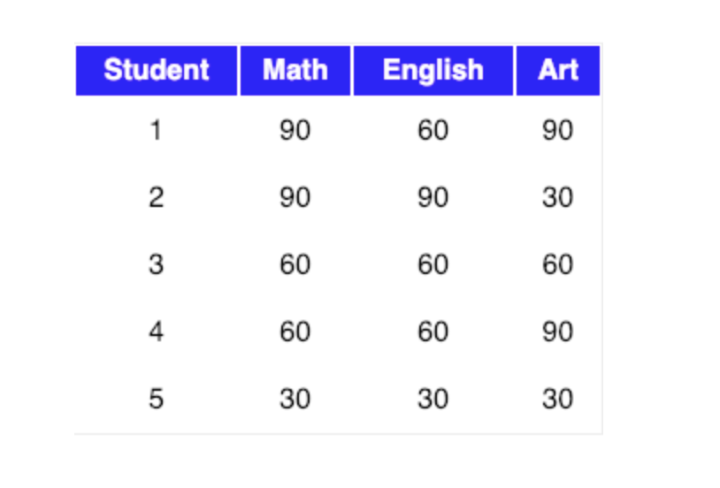
The Mathematics Behind PCA
Let our data matrix X be the score of three students:

Slide 4
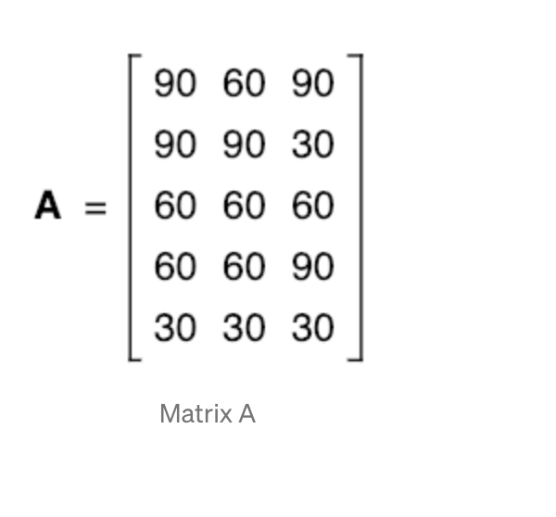
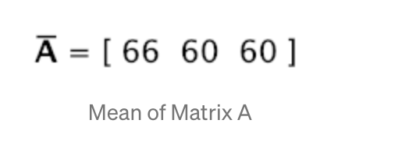
Compute the mean of every dimension of the whole dataset

Slide 5
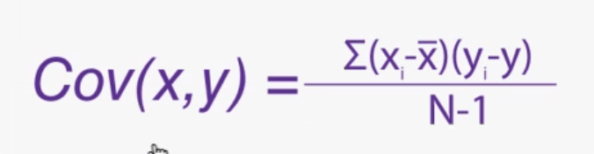
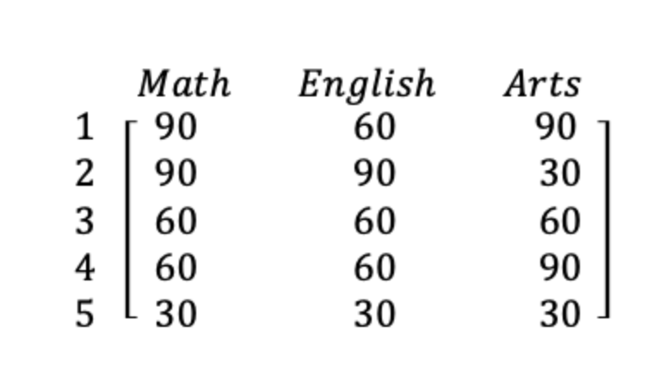
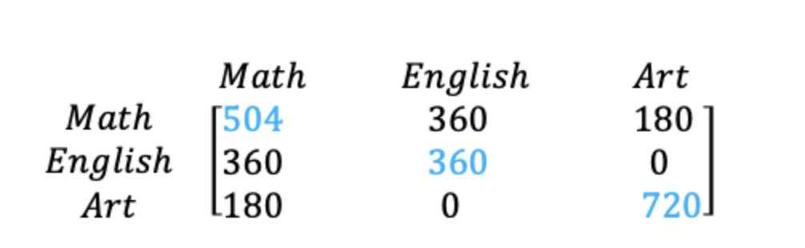
The covariance matrix of the sample can be expressed as
Original Matrix
Covariance Matrix
Notes:
Few points that can be noted here is :
Shown in Blue along the diagonal, we see the variance of scores for each test. The art test has the biggest variance (720); and the English test, the smallest (360). So we can say that art test scores have more variability than English test scores.
The covariance is displayed in black in the off-diagonal elements of the matrix A
a) The covariance between math and English is positive (360), and the covariance between math and art is positive (180). This means the scores tend to covary in a positive way. As scores on math go up, scores on art and English also tend to go up; and vice versa.
b) The covariance between English and art, however, is zero. This means there tends to be no predictable relationship between the movement of English and art scores.

Slide 6
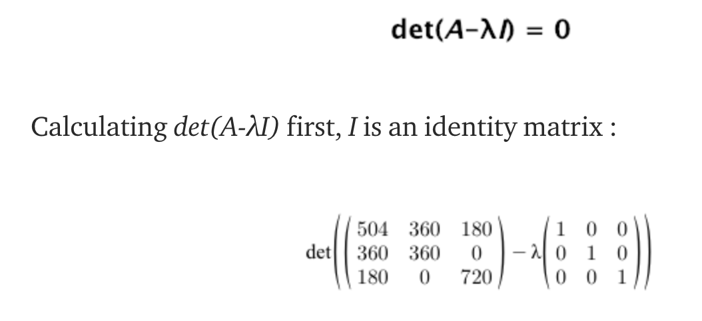
Notes:
Intuitively, an eigenvector is a vector whose direction remains unchanged when a linear transformation is applied to it.
Now, we can easily compute eigenvalue and eigenvectors from the covariance matrix that we have above.
Let A be a square matrix, ν a vector and λ a scalar that satisfies Aν = λν, then λ is called eigenvalue associated with eigenvector ν of A.
The eigenvalues of A are roots of the characteristic equation
Definition of identity matrix - a square matrix in which all the elements of the principal diagonal are ones and all other elements are zeros. The effect of multiplying a given matrix by an identity matrix is to leave the given matrix unchanged.

Slide 7
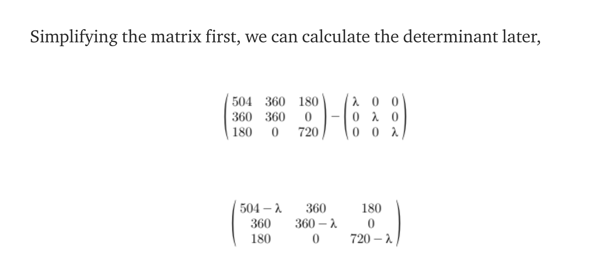
Notes:
Intuitively, an eigenvector is a vector whose direction remains unchanged when a linear transformation is applied to it.
Now, we can easily compute eigenvalue and eigenvectors from the covariance matrix that we have above.
Let A be a square matrix, ν a vector and λ a scalar that satisfies Aν = λν, then λ is called eigenvalue associated with eigenvector ν of A.
The eigenvalues of A are roots of the characteristic equation
Definition of identity matrix - a square matrix in which all the elements of the principal diagonal are ones and all other elements are zeros. The effect of multiplying a given matrix by an identity matrix is to leave the given matrix unchanged.

Slide 8

Notes:
Intuitively, an eigenvector is a vector whose direction remains unchanged when a linear transformation is applied to it.
Now, we can easily compute eigenvalue and eigenvectors from the covariance matrix that we have above.
Let A be a square matrix, ν a vector and λ a scalar that satisfies Aν = λν, then λ is called eigenvalue associated with eigenvector ν of A.
The eigenvalues of A are roots of the characteristic equation
Definition of identity matrix - a square matrix in which all the elements of the principal diagonal are ones and all other elements are zeros. The effect of multiplying a given matrix by an identity matrix is to leave the given matrix unchanged.

Slide 9
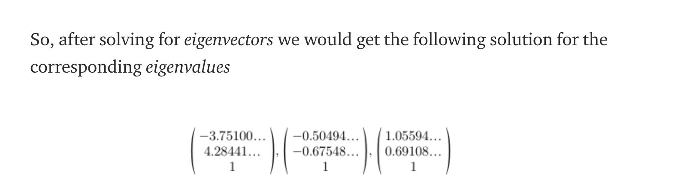
Now, we can calculate the eigenvectors corresponding to the above eigenvalues.
Notes:
Intuitively, an eigenvector is a vector whose direction remains unchanged when a linear transformation is applied to it.
Now, we can easily compute eigenvalue and eigenvectors from the covariance matrix that we have above.
Let A be a square matrix, ν a vector and λ a scalar that satisfies Aν = λν, then λ is called eigenvalue associated with eigenvector ν of A.
The eigenvalues of A are roots of the characteristic equation
Definition of identity matrix - a square matrix in which all the elements of the principal diagonal are ones and all other elements are zeros. The effect of multiplying a given matrix by an identity matrix is to leave the given matrix unchanged.

Slide 10
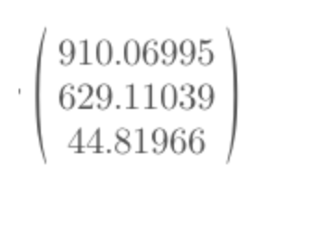
To decide which eigenvector(s) we want to drop for our lower-dimensional subspace, we have to take a look at the corresponding eigenvalues of the eigenvectors. Roughly speaking, the eigenvectors with the lowest eigenvalues bear the least information about the distribution of the data.
So, after sorting the eigenvalues in decreasing order, we have drop.
Notes:
So, in order to decide which eigenvector(s) we want to drop for our lower-dimensional subspace, we have to take a look at the corresponding eigenvalues of the eigenvectors. Roughly speaking, the eigenvectors with the lowest eigenvalues bear the least information about the distribution of the data, and those are the ones we want to drop.
The common approach is to rank the eigenvectors from highest to lowest corresponding eigenvalue and choose the top k eigenvectors.
So, after sorting the eigenvalues in decreasing order, we have

Slide 11
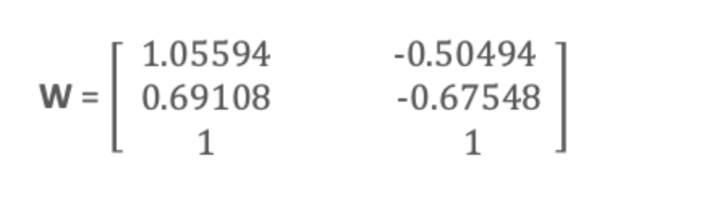
For our simple example, where we are reducing a 3-dimensional feature space to a 2-dimensional feature subspace, we are combining the two eigenvectors with the highest eigenvalues to construct our d×k dimensional eigenvector matrix W.
So, eigenvectors corresponding to two maximum eigenvalues are:
Notes:
So, in order to decide which eigenvector(s) we want to drop for our lower-dimensional subspace, we have to take a look at the corresponding eigenvalues of the eigenvectors. Roughly speaking, the eigenvectors with the lowest eigenvalues bear the least information about the distribution of the data, and those are the ones we want to drop.
The common approach is to rank the eigenvectors from highest to lowest corresponding eigenvalue and choose the top k eigenvectors.
So, after sorting the eigenvalues in decreasing order, we have

Slide 12
Transform the samples onto the new subspace
In the last step, we use the 3x2 dimensional matrix W that we just computed to transform our samples onto the new subspace via the equation y = W′ × x where W′ is the transpose of the matrix W.
So lastly, we have computed our two principal components and projected the data points onto the new subspace.
Notes:
So, in order to decide which eigenvector(s) we want to drop for our lower-dimensional subspace, we have to take a look at the corresponding eigenvalues of the eigenvectors. Roughly speaking, the eigenvectors with the lowest eigenvalues bear the least information about the distribution of the data, and those are the ones we want to drop.
The common approach is to rank the eigenvectors from highest to lowest corresponding eigenvalue and choose the top k eigenvectors.
So, after sorting the eigenvalues in decreasing order, we have

Slide 13
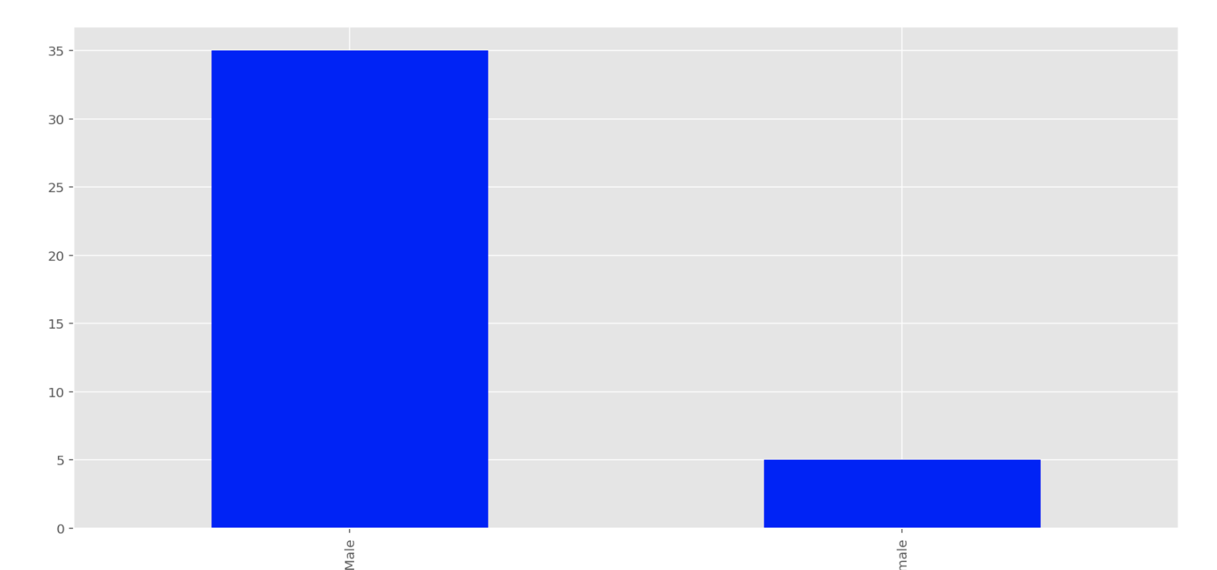
Bogota 0 No Transparency
Q17 - What is your gender?

Slide 14
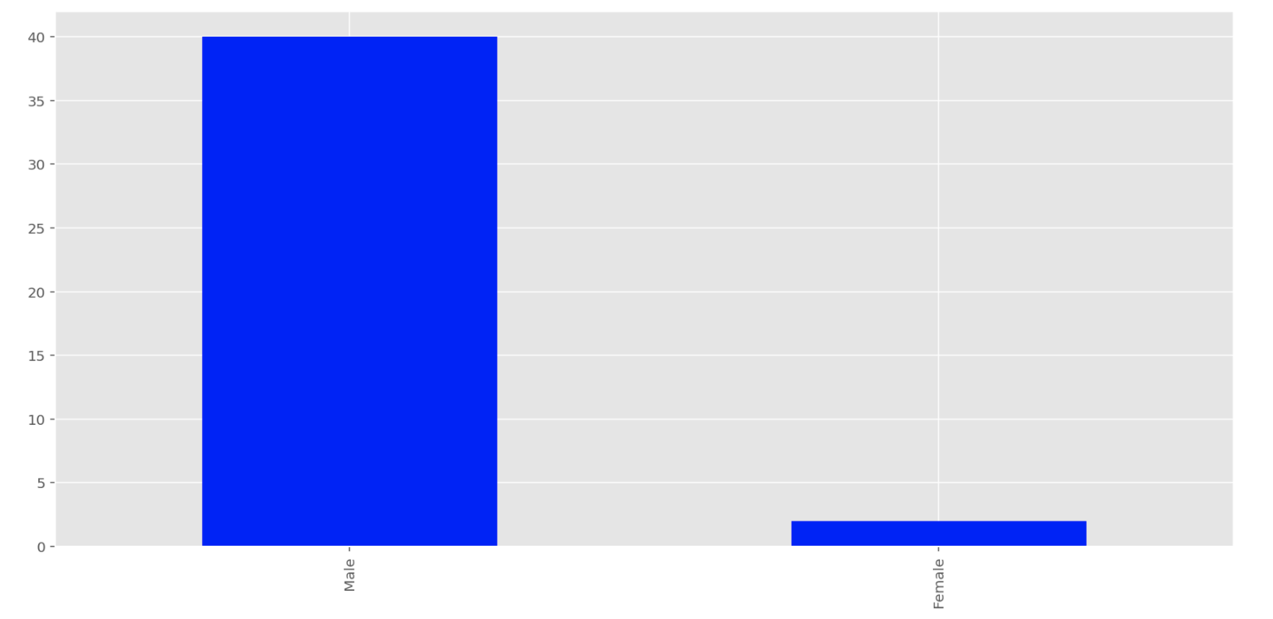
Bogota 1 Performance Transparency
Q17 - What is your gender?

Slide 15
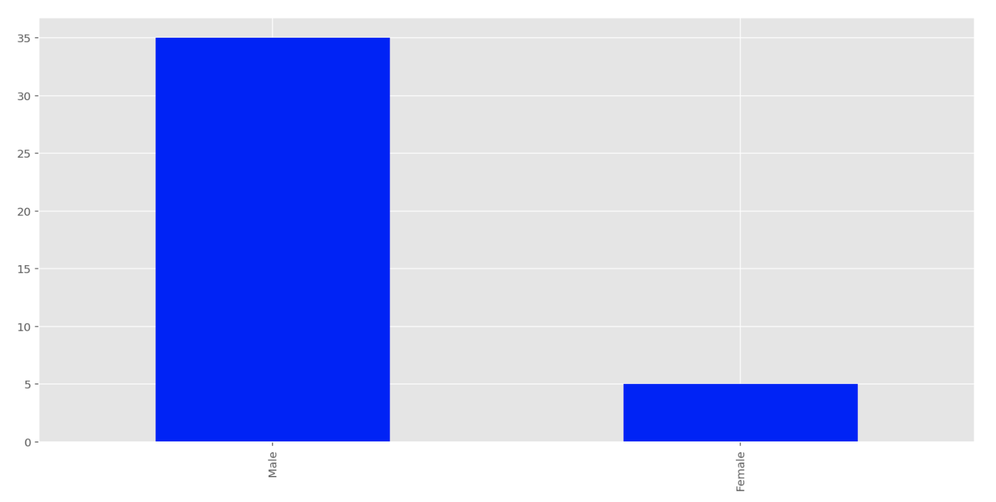
Bogota 2 Solution Transparency
Q17 - What is your gender?

Slide 16
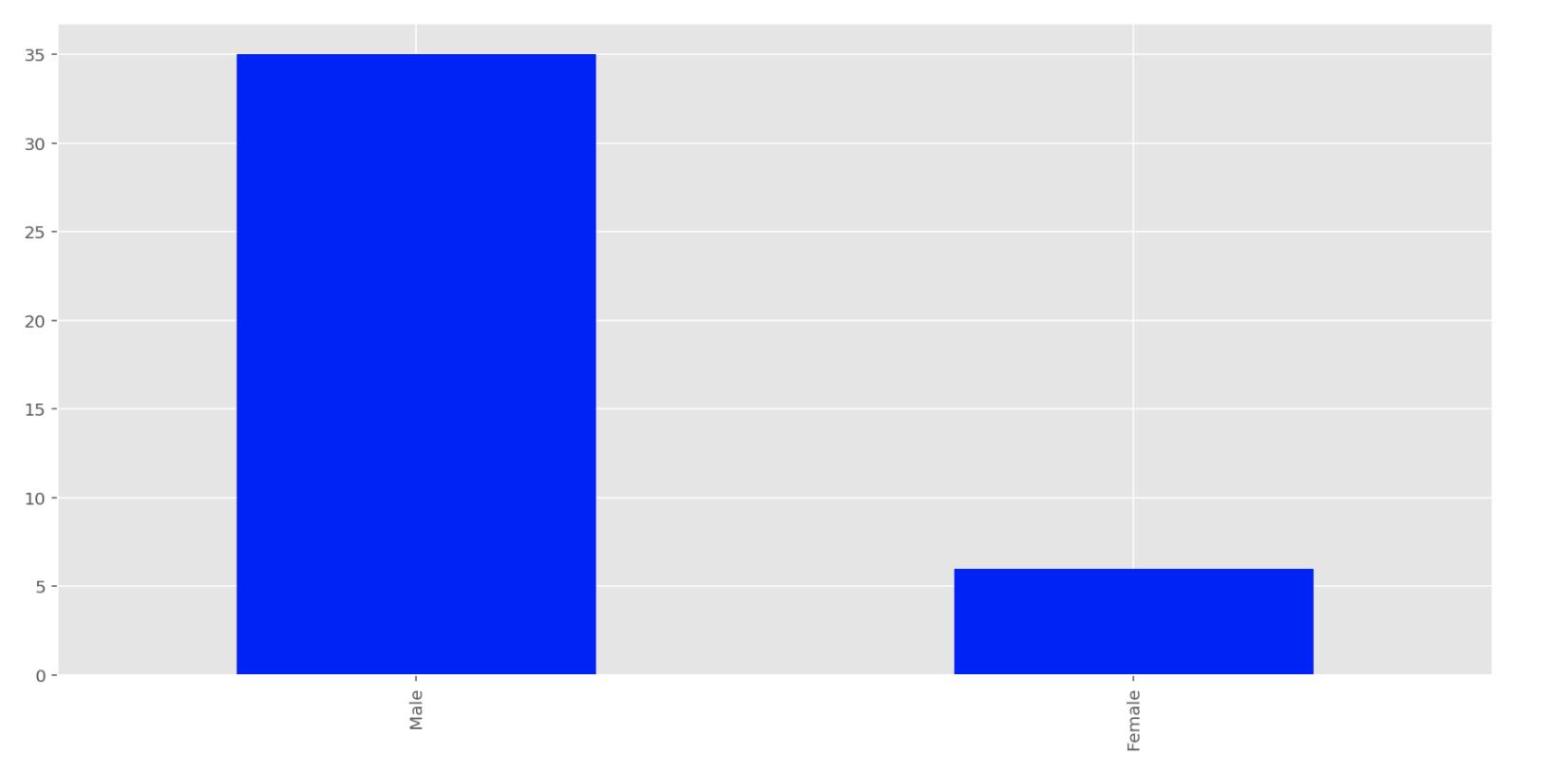
Bogota 3 Full Transparency
Q17 - What is your gender?

Slide 17
Interpretation: Q17 – What is your gender
Majority of the participants are male in all 4 treatment groups

Slide 18
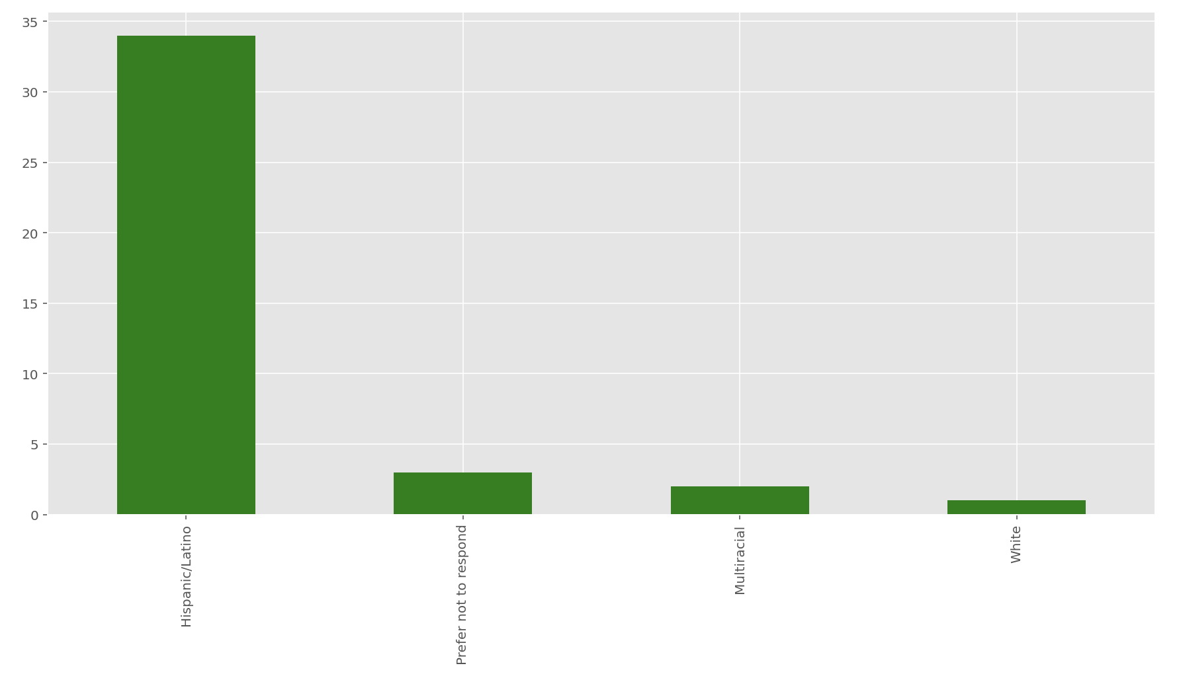
Bogota 0 No Transparency
Q18 - What is your race/ethnicity?

Slide 19
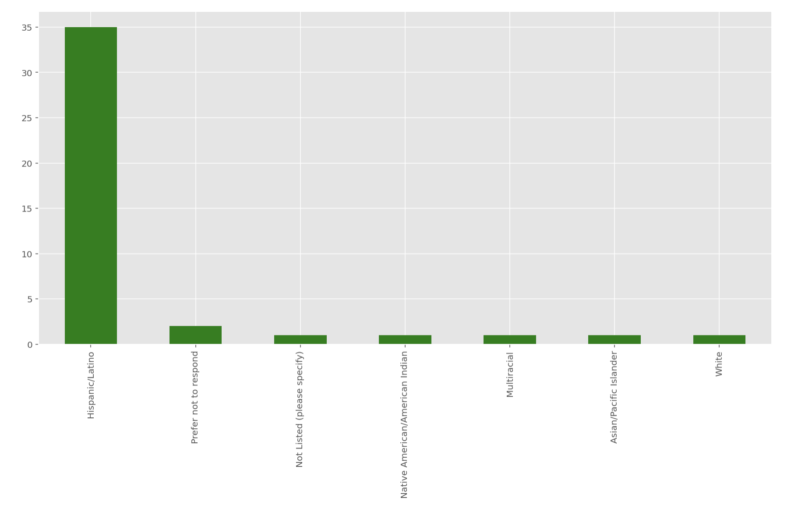
Bogota 1 Performance Transparency
Q18 - What is your race/ethnicity?

Slide 20
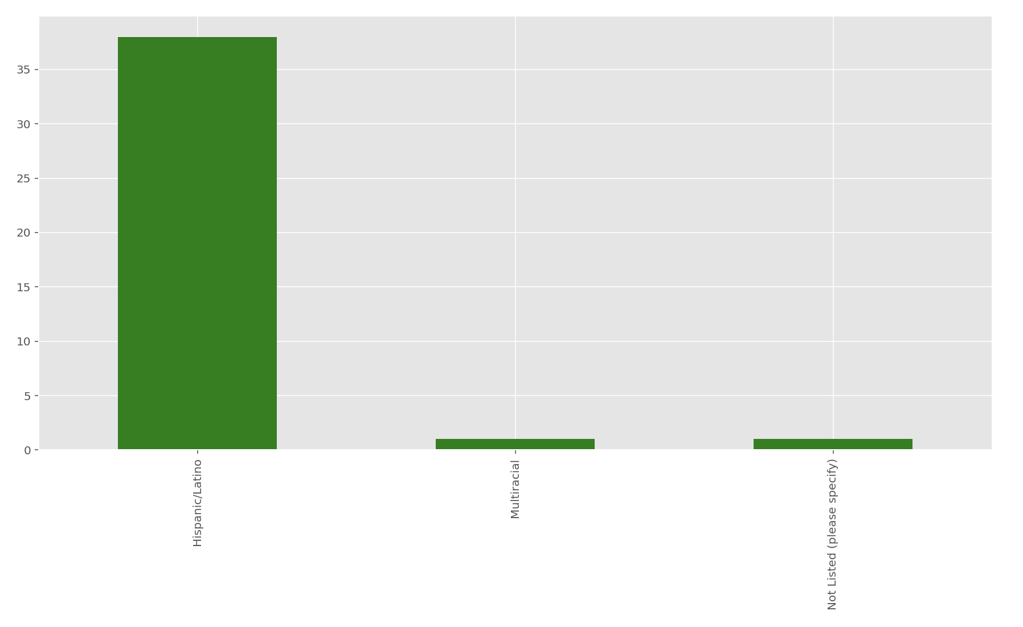
Bogota 2 Solution Transparency
Q18 - What is your race/ethnicity?

Slide 21
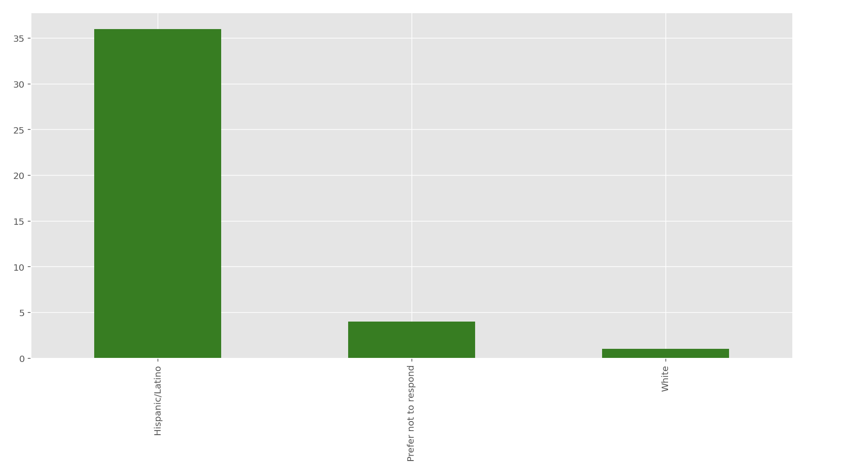
Bogota 3 Full Transparency
Q18 - What is your race/ethnicity?

Slide 22
Interpretation: Q18 - What is your race/ethnicity?
Majority of the participants are Hispanic/Latino in all 4 treatment groups

Slide 23
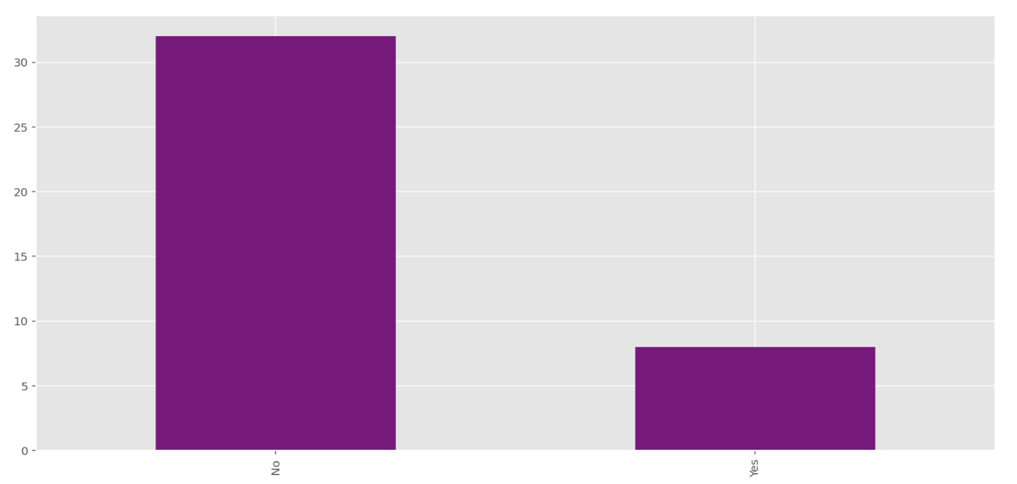
Bogota 0 No Transparency
Q9 - Have you participated in any programming competition before (e.g. Topcoder.com, local hacking events etc.)?

Slide 24
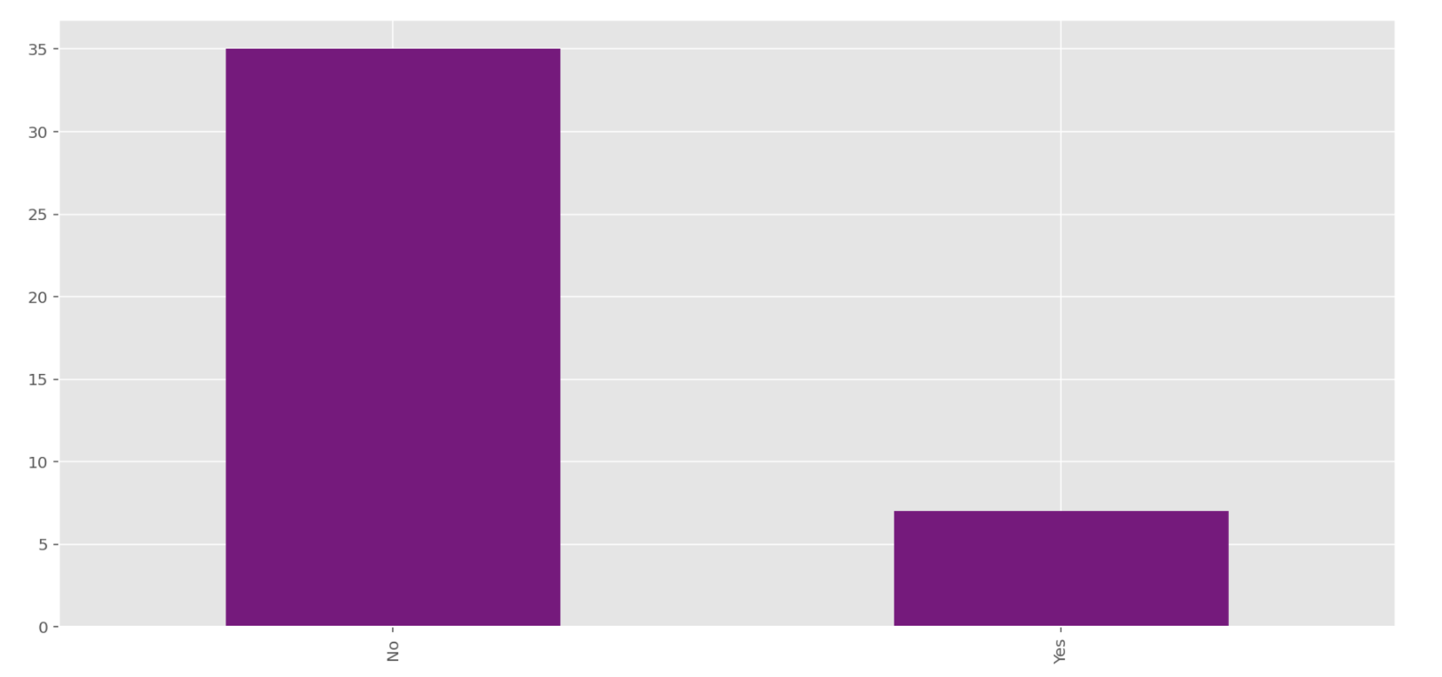
Bogota 1 Performance Transparency
Q9 - Have you participated in any programming competition before (e.g. Topcoder.com, local hacking events etc.)?

Slide 25
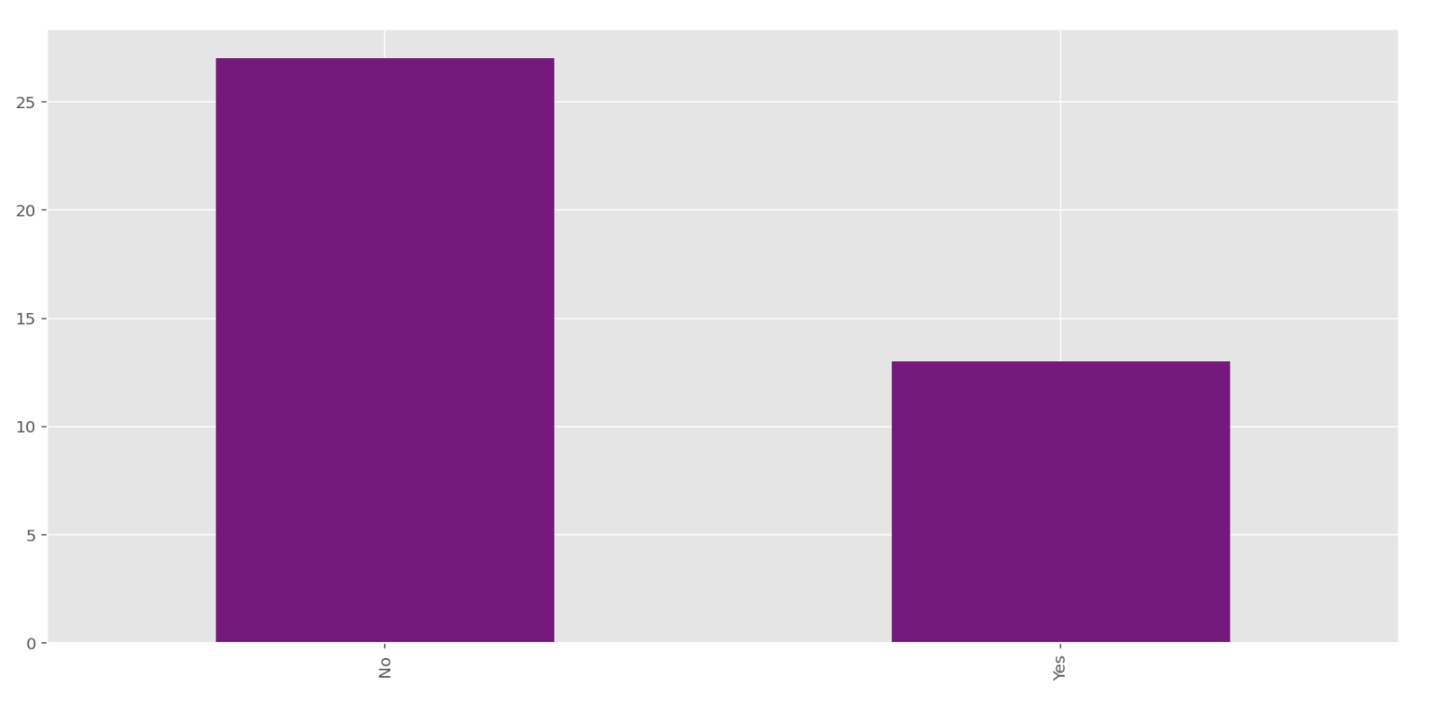
Bogota 2 Solution Transparency
Q9 - Have you participated in any programming competition before (e.g. Topcoder.com, local hacking events etc.)?

Slide 26
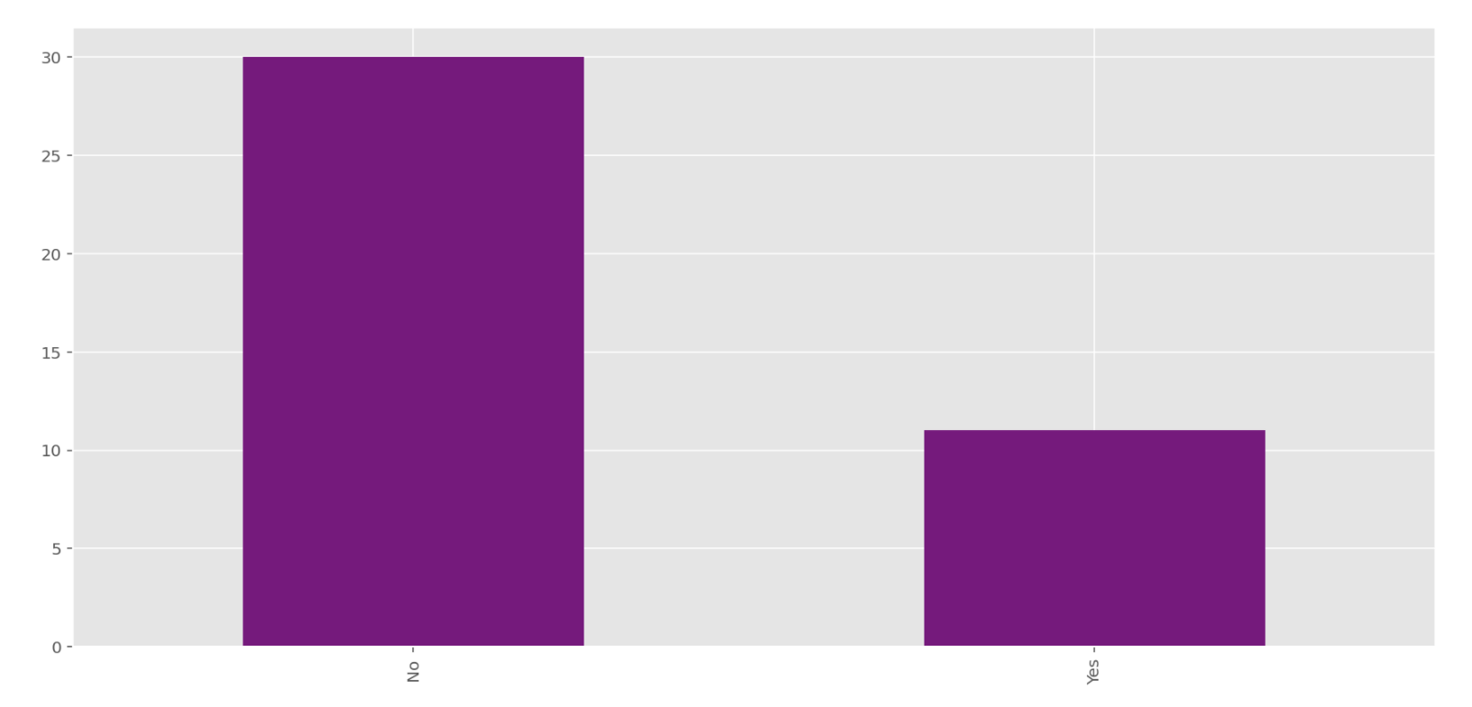
Bogota 3 Full Transparency
Q9 - Have you participated in any programming competition before (e.g. Topcoder.com, local hacking events etc.)?

Slide 27
Interpretation: Q9 - Have you participated in any programming competition before (e.g. Topcoder.com, local hacking events etc.)?
Majority of the participants have not participated in any programming competition before in all 4 groups.

Slide 28
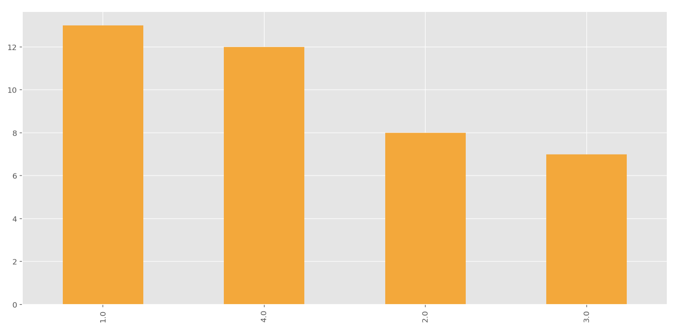
Bogota 0 No Transparency
Q24 - In which of the following classes are you enrolled?

Slide 29
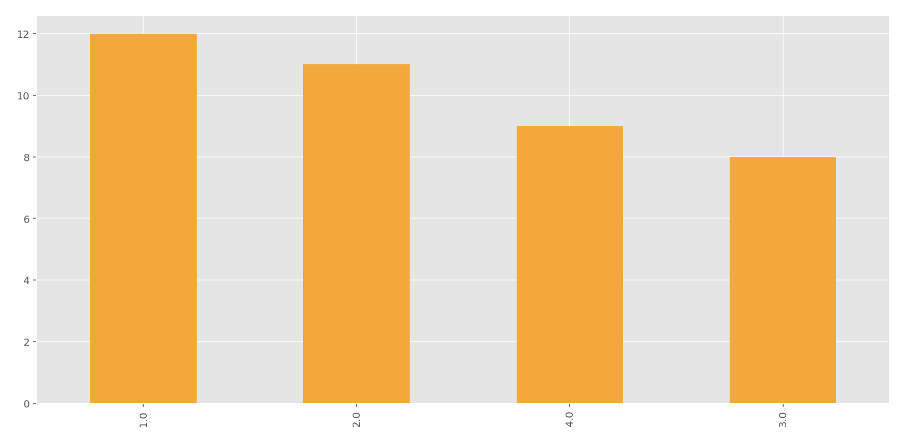
Bogota 1 Performance Transparency
Q24 - In which of the following classes are you enrolled?

Slide 30
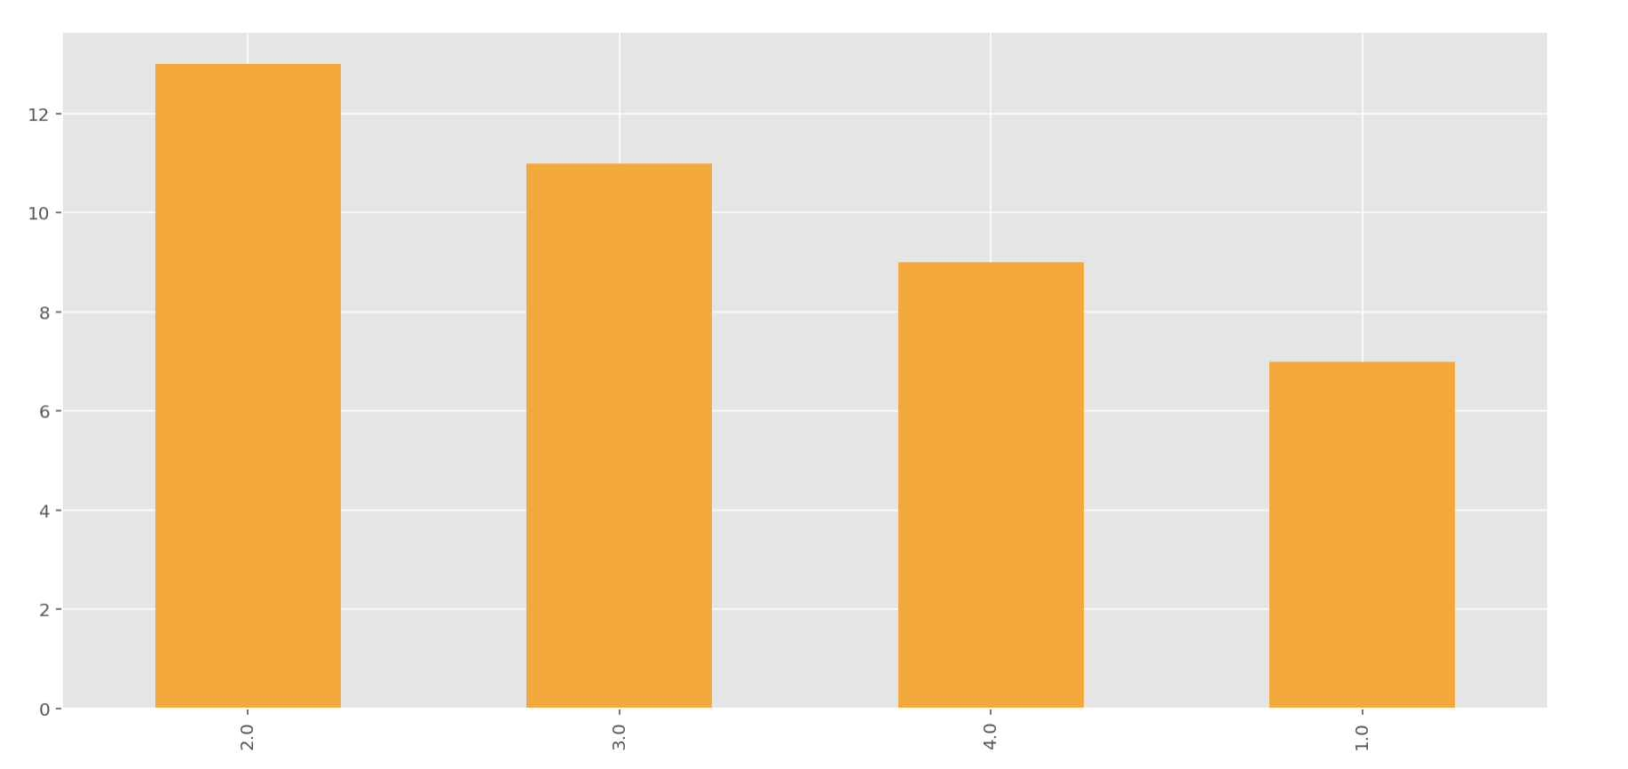
Bogota 2 Solution Transparency
Q24 - In which of the following classes are you enrolled?

Slide 31
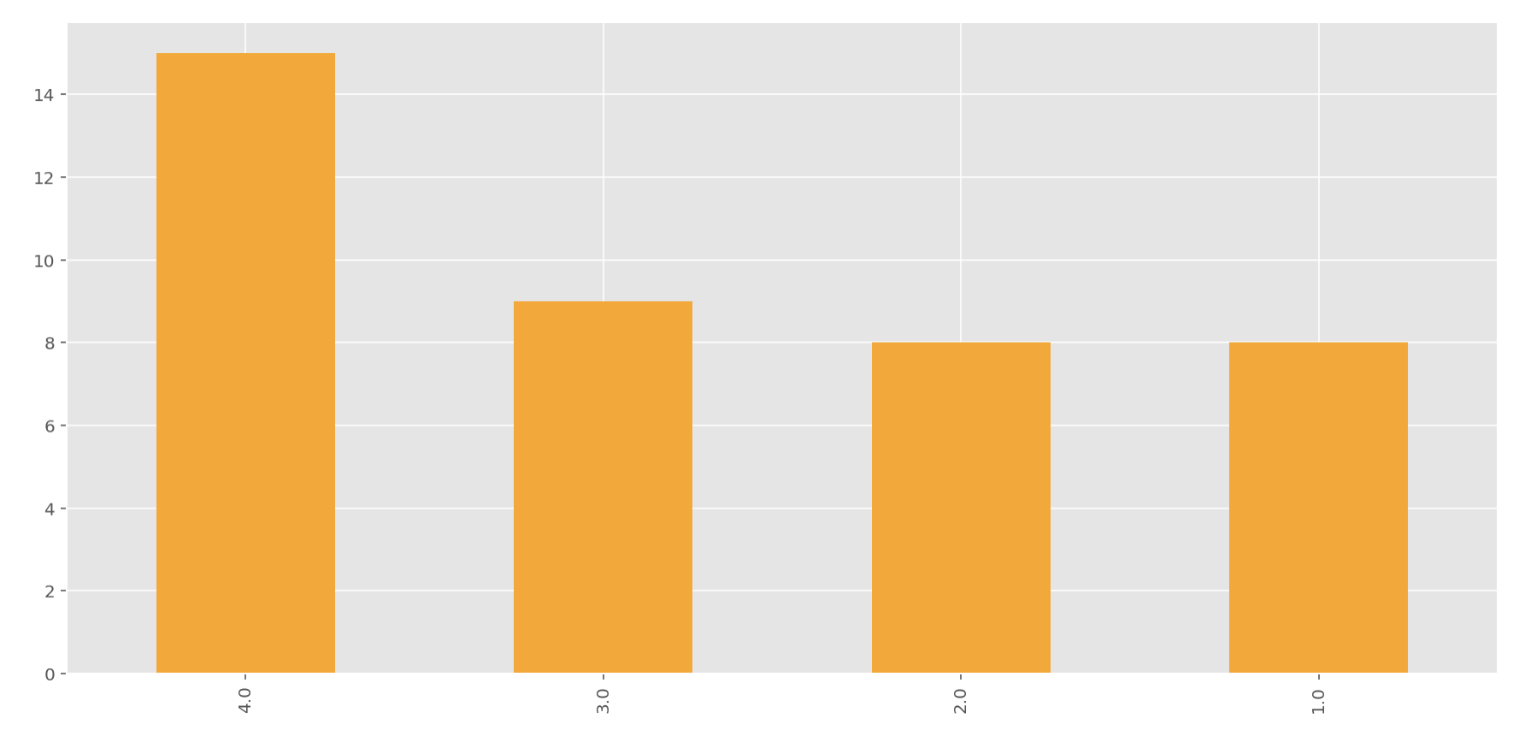
Bogota 3 Full Transparency
Q24 - In which of the following classes are you enrolled?

Slide 32
Interpretation: Q24 - In which of the following classes are you enrolled?
In all of the 4 groups, participants come from all 4 software engineering classes.

Slide 33
The Kaiser-Meyer-Olkin Measure of Sampling Adequacy is a statistic that indicates the proportion of variance in your variables that might be caused by underlying factors. High values (close to 1.0) generally indicate that a factor analysis may be useful for the data. If the value is less than 0.50, the results of the factor analysis probably won’t be very useful. Previous studies have suggested that KMO greater than 0.5 can be used for factor analysis, while KMO greater than 0.8 is very suitable for factor analysis. r
• Li, N., Huang, J., & Feng, Y. (2020). Construction and confirmatory factor analysis of the core cognitive ability index system of ship C2 system operators. PloS one, 15(8), e0237339. https://doi.org/10.1371/journal.pone.0237339
• Kaiser, H. F. (1974). An index of factorial simplicity. Psychometrika, 39(1), 31-36.

Slide 34
IDEAL VARIANCE RANGE The total value of Total Variance Explained should be between 50% and 90% for factor analysis.
Dawson, J. (2016). Analysing quantitative survey data for business and management students. Sage.
While performing EFA using Principal Axis Factoring with Promax rotation, Osborne,
Costello, & Kellow (2008) suggests the communalities above 0.4 is acceptable
Costello, AB & Osborne, Jason. (2005). Best Practices in Exploratory Factor Analysis: Four Recommendations for Getting the Most From Your Analysis. Practical Assessment, Research & Evaluation. 10. 1-9.

Slide 35
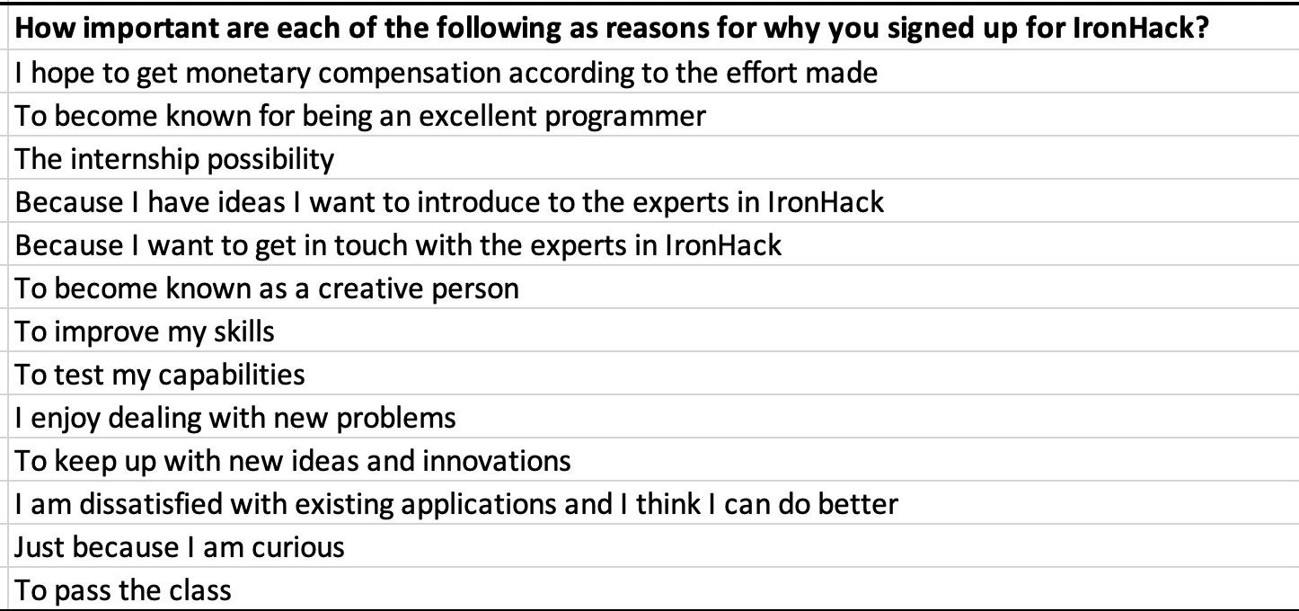
Survey Q2 Motivations
How important are each of the following as reasons for why you signed up for IronHack?
Cronbach’s alpha (0.8740) (Good Consistency)
KMO ( 0.9252 ) ( adequate )
Barlett’s Test ( 5.3826e-23) ( significant )

Slide 36
Drawing on the rich body of motivation research found in related fields such as user innovation, consumer creativity, and open-source software, 10 motive categories—intrinsic playful task, curiosity, self efficacy, skill development, information seeking, recognition (visibility,), community support, making friends, personal need (dissatisfaction), and compensation (monetary reward)— have been identified that may explain why consumers engage in virtual co-creation projects initiated by producers (see Table 1).

Slide 37
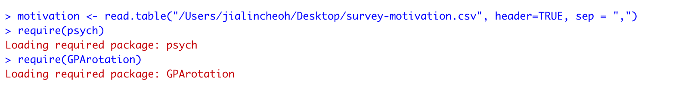
Steps EFA for Survey Construct Motivations

Slide 38
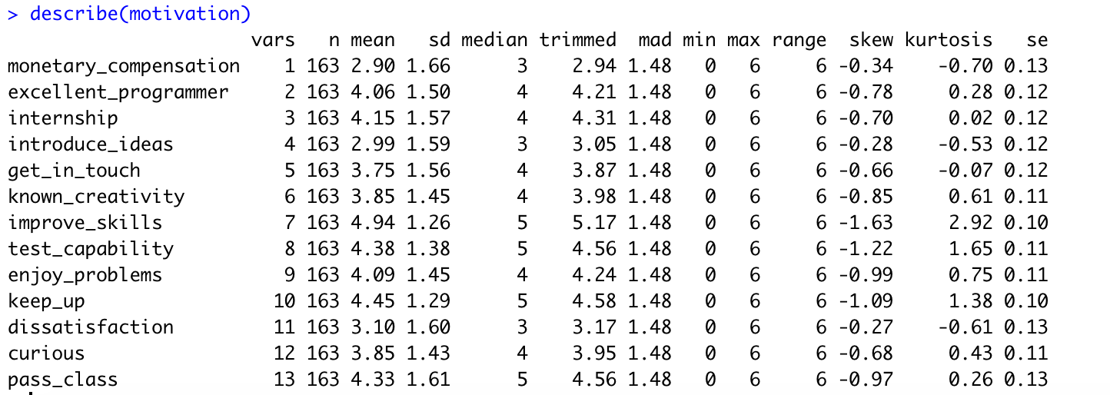

Slide 39
Response distributions for most items are approximately normal; the improve_skills, test_capability, keep_up items have excessive skewness, and the improve_skills item also has high kurtosis.
Looking forward, we might expect some bias (inaccuracy) in the factor loading estimates for the improve_skills item, particularly, but the maximum likelihood estimation that will be used for FA has some robustness to non-normality.

Slide 40
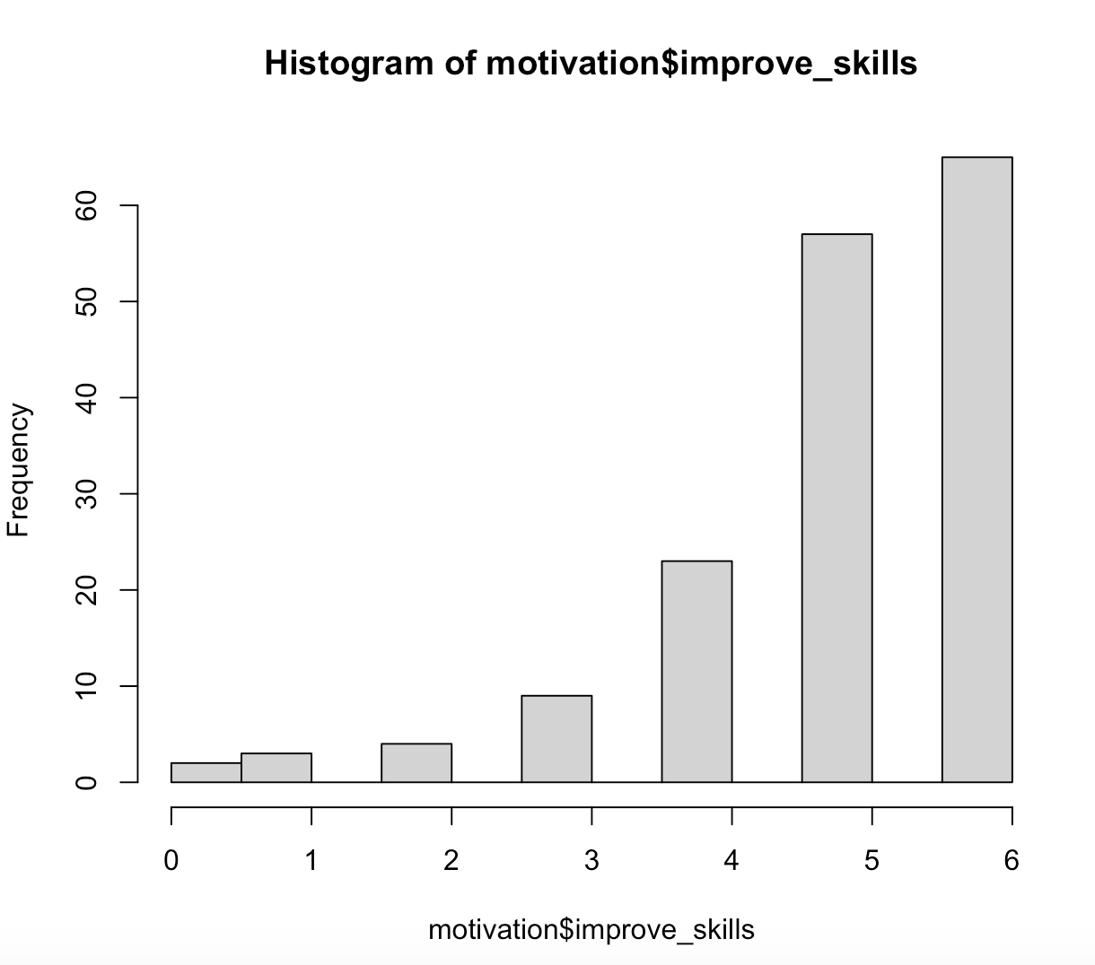
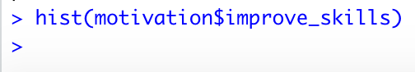

Slide 41
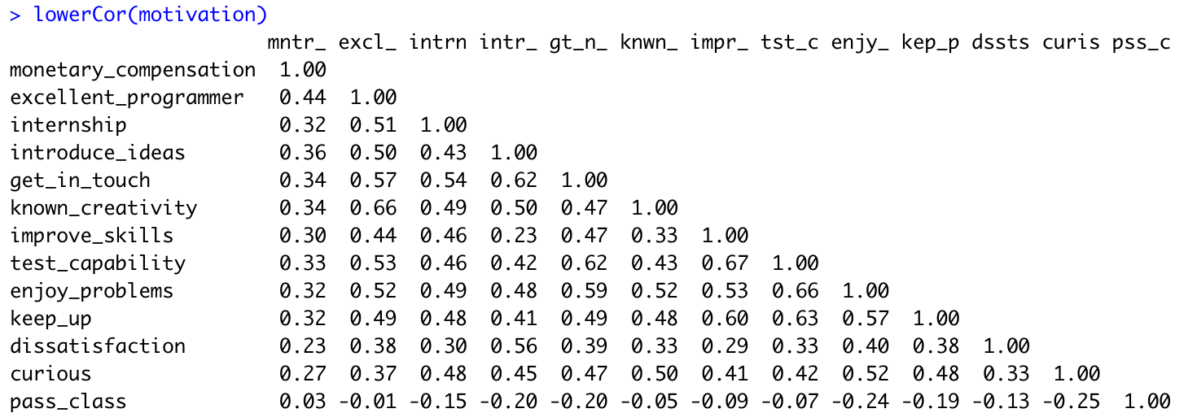

Slide 42
Pearson correlations indicate the items have non-trivial pairwise interrelationships. Particularly, none of the item pairs have near-zero or very small correlations. The weakest correlations appear to be between the ‘pass_class’ item and other items. Some item response pairs have positive, and others have negative, associations.

Slide 43
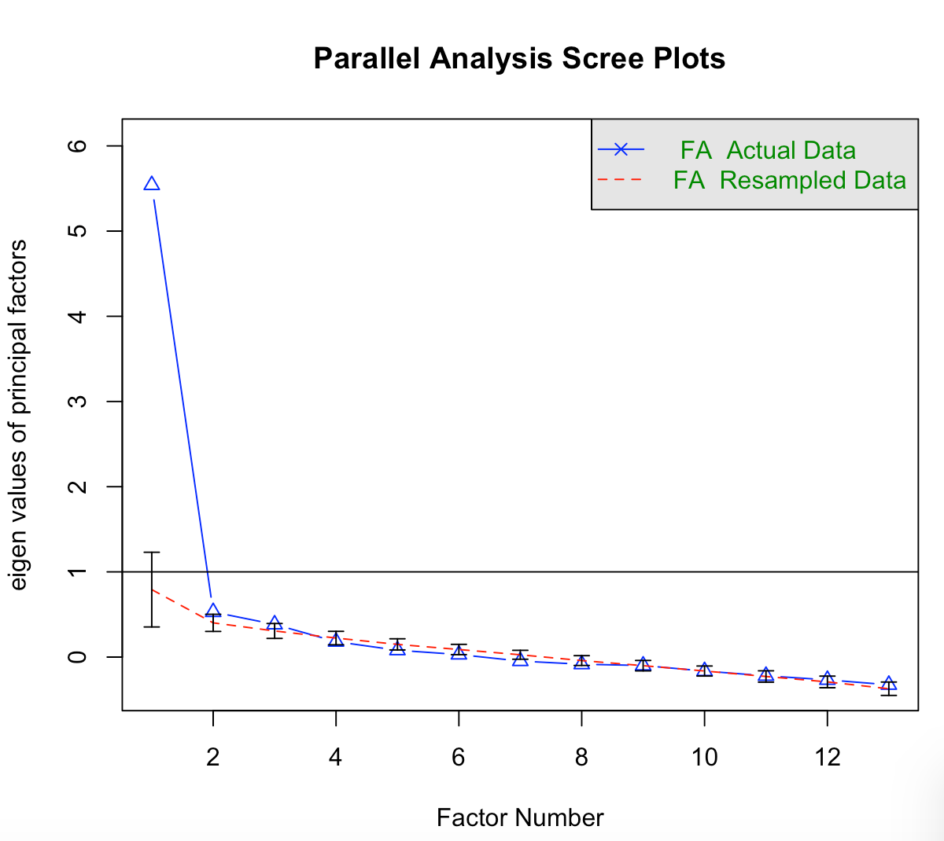

Slide 44
Based on the parallel analysis result and our initial hypothesis, we might compare models with 2 and 3 factors.
Parallel analysis suggests 3 factors have eigenvalues that clearly exceed those from a randomly-arranged dataset of the same size. The 4th factor is questionable from a parsimony perspective because its eigenvalue just barely exceeds that expected from a random dataset.
Preferred models should have the fewest factors possible, but still all or mostly acceptable fit indices (chi-square, RMSR, and TLI) and be substantively interpretable (i.e., the pattern of loadings can be reasonably explained based on theory about the trait and/or knowledge of the item content). Models with more factors will usually fit better because they have more parameters, so it is important that the added factors are interpretable. A model should not have so many factors that many items have no loadings above .4. The order of importance of these criteria in making an overall judgment is substantive interpretability, and then model fit and parsimony.

Slide 45
• Rotation: You can do an oblique rotation first (oblimin, promax), and examine the component correlation matrix. If the correlation between the components is not important, you can repeat the analysis with varimax rotation. The latter will maximize the factor loadings, assuming no correlations between components. If there are important correlations between the components, then you can save the factor scores and perform a second-order principal component analysis on them. OR, you can discuss the component correlations themselves, depending on the research question.
You use varimax in EFA when You assume that in population factors you extract are not correlated; You use promax or other oblique rotations when You assume that they are correlated

Slide 46
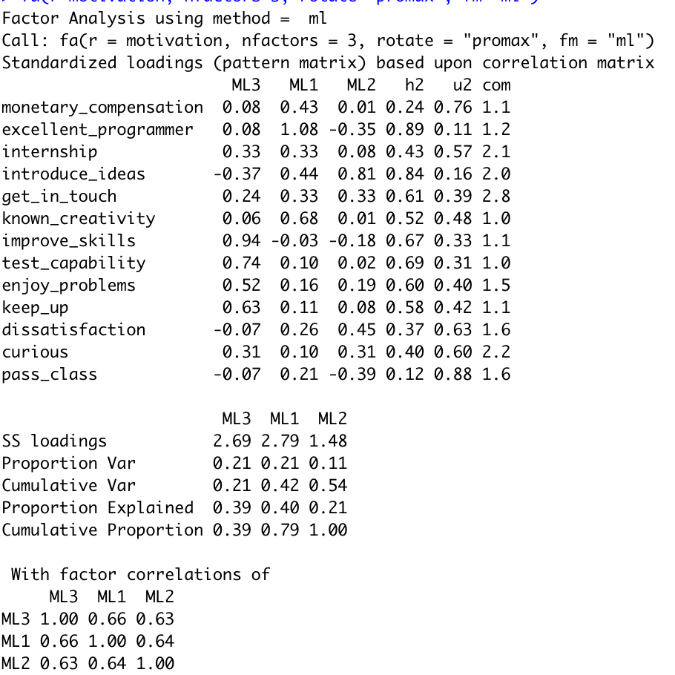
Factor 1
( gain knowledge ) –
improve skills
and
test capability
and ( intrinsic innovation interest ) – enjoy problems, keep up with new ideas
Factor 2 ( recognition ) –
Known as excellent programmer, creativity
Factor 3 (

Slide 47
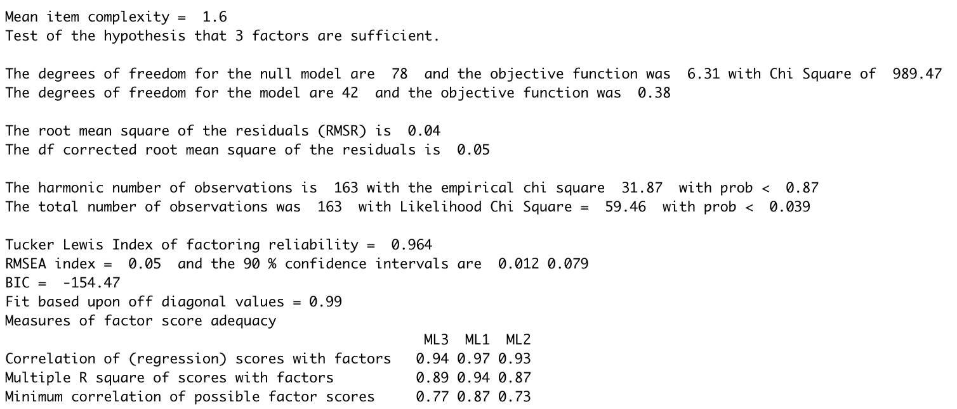
Notes:
# Tucker Lewis Index is a model fit statistic. Rule-of-thumb is that models with TLI > .90 fit the data well (Little, 2013, Longitudinal structural equation modeling)
# Chi-square test of model fit (below) tests the null hypothesis that “The model fits the data.” Want prob [p-value] > .05 to suggest that model fits data well. With “large” samples (say, greater than 400-500), minor misfit between each person’s data and the model may accumulate to produce a significant chi-square value.
# Root mean square error of approximation (RMSEA) is another model fit statistic. Rule-of-thumb is that models with RMSEA ≤ .05 fit the data well, ≤ .08 fit the data acceptably, and .08 - .10 is marginally acceptable fit (Little, 2013).

Slide 48
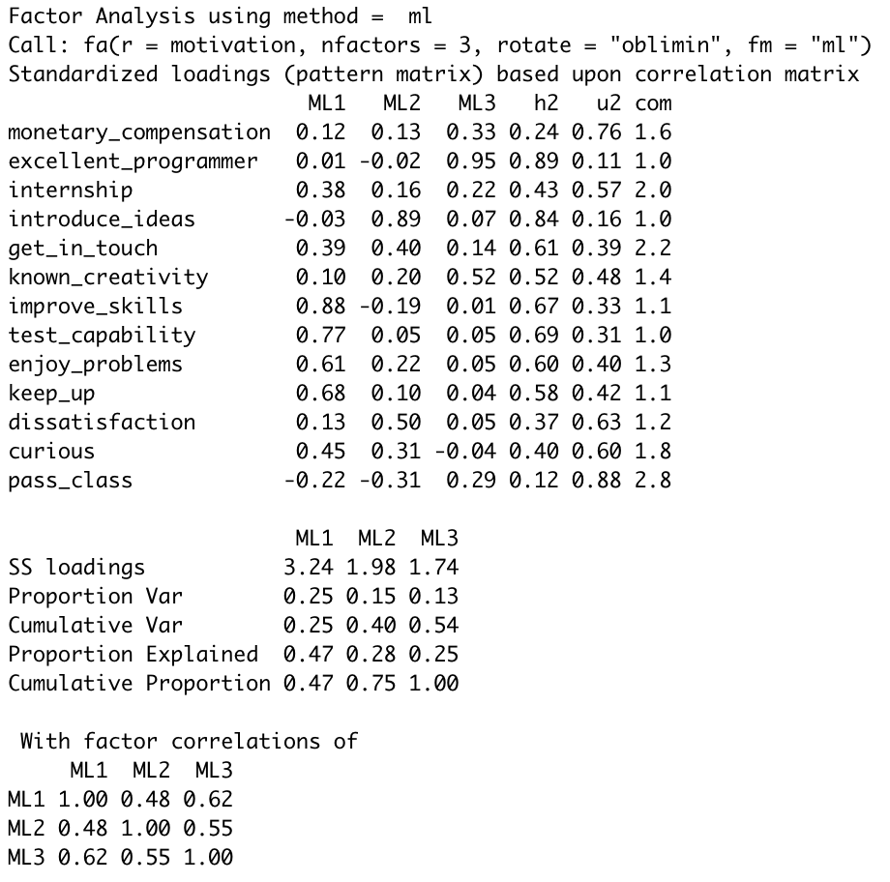
Factor 1
( gain knowledge ) –
improve skills
and
test capability
and ( intrinsic innovation interest ) – enjoy problems, keep up with new ideas
and ( curiosity ) - curious
Factor 2 ( show ideas ) –
Introduce ideas and get in touch
( dissatisfaction ) – dissatisfied
Factor 3 ( recognition ) – known as excellent programmer, known for creativity

Slide 49
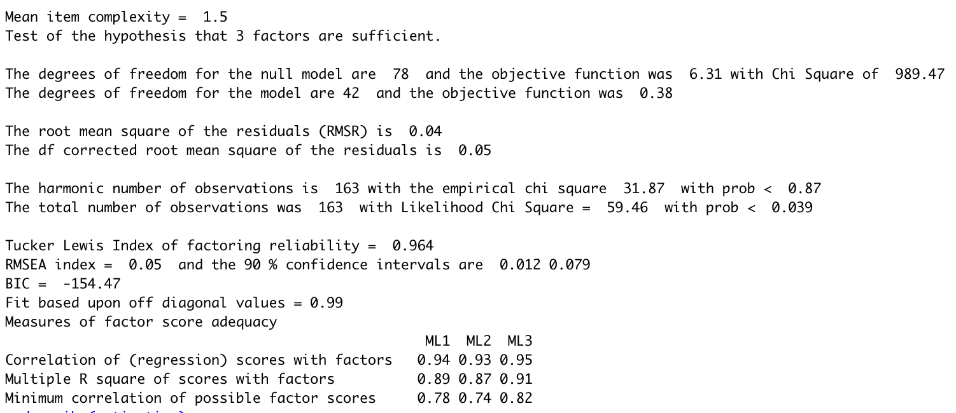
Notes:
# Tucker Lewis Index is a model fit statistic. Rule-of-thumb is that models with TLI > .90 fit the data well (Little, 2013, Longitudinal structural equation modeling)
# Chi-square test of model fit (below) tests the null hypothesis that “The model fits the data.” Want prob [p-value] > .05 to suggest that model fits data well. With “large” samples (say, greater than 400-500), minor misfit between each person’s data and the model may accumulate to produce a significant chi-square value.
# Root mean square error of approximation (RMSEA) is another model fit statistic. Rule-of-thumb is that models with RMSEA ≤ .05 fit the data well, ≤ .08 fit the data acceptably, and .08 - .10 is marginally acceptable fit (Little, 2013).

Slide 50
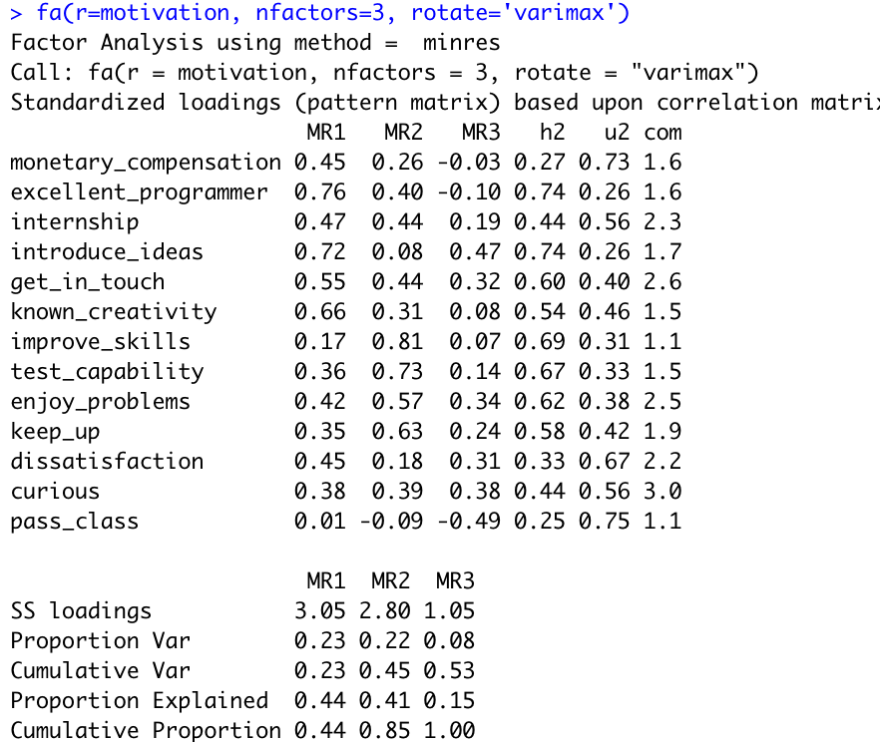

Slide 51
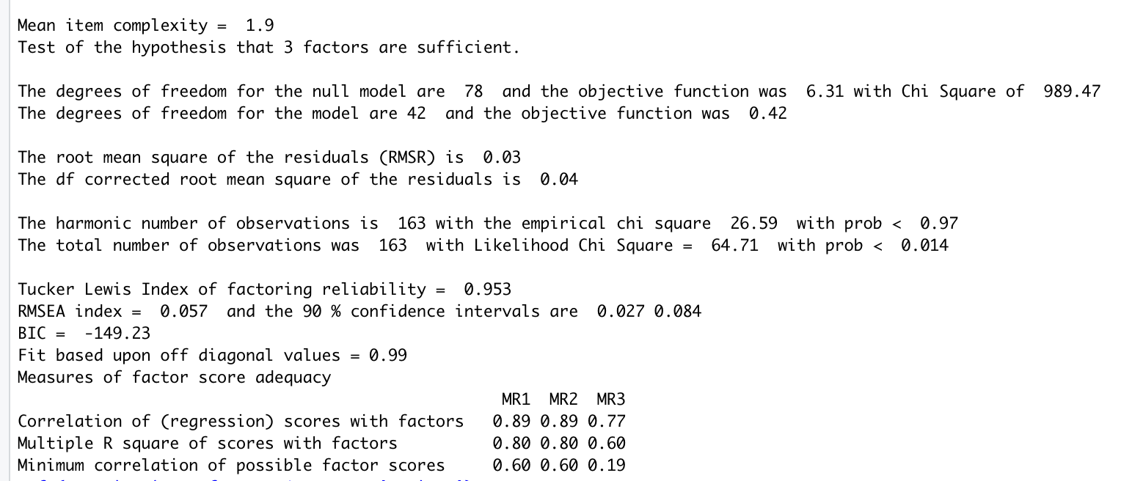
Notes:
# Tucker Lewis Index is a model fit statistic. Rule-of-thumb is that models with TLI > .90 fit the data well (Little, 2013, Longitudinal structural equation modeling)
# Chi-square test of model fit (below) tests the null hypothesis that “The model fits the data.” Want prob [p-value] > .05 to suggest that model fits data well. With “large” samples (say, greater than 400-500), minor misfit between each person’s data and the model may accumulate to produce a significant chi-square value.
# Root mean square error of approximation (RMSEA) is another model fit statistic. Rule-of-thumb is that models with RMSEA ≤ .05 fit the data well, ≤ .08 fit the data acceptably, and .08 - .10 is marginally acceptable fit (Little, 2013).

Slide 52
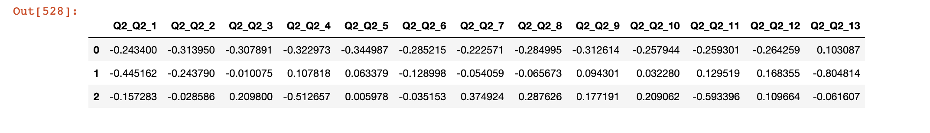
PCA Survey Q2
Three Principle Components Explained 63.65% of the Variance.
PC1 explained 45.49% of the variance - Person with high value for PC1 will have low Q4 (0.323 ) and low Q5 ( 0.345 ) and low Q2 ( 0.314 )
PC2 explained 10.15% of the variance – Person with high value for PC2 will have low Q13 ( 0.805 ) and low Q1 ( 0.445 ).
PC3 explained 8.01% of the variance – Person with high value for PC3 will have low Q4 ( 0.5127 ).

Slide 53
PCA Survey Q2
Features by importance:
[(5.839735054043034, 'Q2_Q2_13'), (4.636818964269485, 'Q2_Q2_5'), (4.538149110813588, 'Q2_Q2_2'), (4.522662372716051, 'Q2_Q2_1'), (4.387088637503117, 'Q2_Q2_4'), (4.234664206641395, 'Q2_Q2_9'), (4.119574038933979, 'Q2_Q2_3'), (3.922502790812984, 'Q2_Q2_6'), (3.840675387905758, 'Q2_Q2_8'), (3.7292214581674994, 'Q2_Q2_12'), (3.5871174171973936, 'Q2_Q2_11'), (3.458266845317514, 'Q2_Q2_10'), (3.001852776427413, 'Q2_Q2_7')]
Interpretation: Q2_Q2_5 [ Q5 ] is 'Because I want to get in touch with the experts in IronHacks’ [ 2nd important ]
Q2_Q2_13 [ Q13 ] is 'To pass the class’ [ most important ]
Q2_Q2_2 [ Q2 ] is ‘To become known for being an excellent programmer’
[ 3rd important ]
Q2_Q2_1 [ Q1 ] is ‘I hope to get monetary compensation according to the effort made’ [ 4th important ]
Q2_Q2_4 [ Q4 ] is ‘Because I have ideas I want to introduce to the experts in IronHacks’ [ 5th important ]

Slide 54
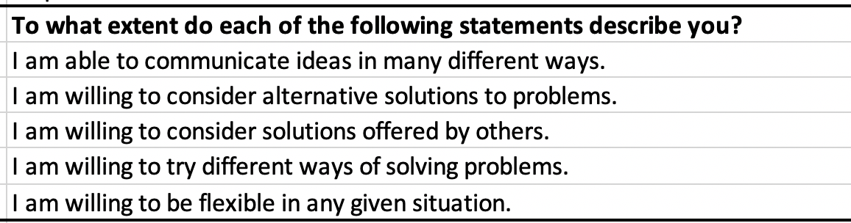
PCA Survey Q3 Openness/flexibilty
To what extent do each of the following statements describe you?
Cronbach’s alpha (0.8004) (Good Consistency)
KMO ( 0.764 ) ( adequate )
Barlett’s Test ( 1.822e-55 ) ( significant )

Slide 55
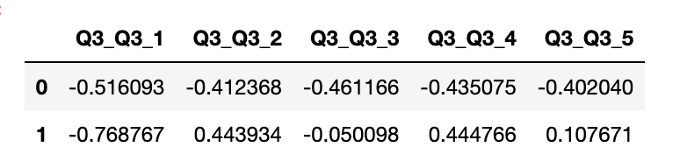
PCA Survey Q3
Two Principle Components Explained 75.11% of the Variance.
PC1 explained 55.93% of the variance - Person with High Value for PC1 will have
low Q1 ( 0.516 ) and low Q3 ( 0.461 )
PC2 explained 19.18% of the variance – Person with High Value for PC2 will have
low Q1 ( 0.7688 ) and high Q4 ( 0.4448 )

Slide 56
PCA Survey Q3
Interpretation: Q3_Q3_1 [ Q1 ] is 'I am able to communicate ideas in many different ways’ [ most important ]
Q3_Q3_3 [ Q3 ] is ‘I am willing to consider solutions offered by others’ [ 2nd important ]
Q3_Q3_4 [ Q4 ] is ‘I am willing to try different ways of solving problems’ [ 3rd important ]

Slide 57
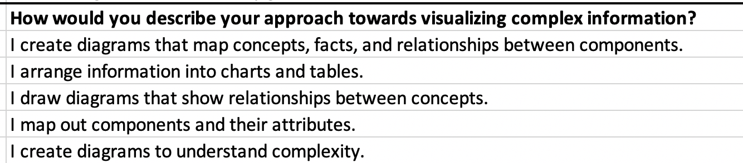
PCA Survey Q4 Skill level
How would you describe your approach towards visualizing complex information?
Cronbach’s alpha (0.8158) (Good Consistency)
KMO ( 0.8006 ) ( adequate )
Barlett’s Test ( 2.7514e-58 ) ( significant )

Slide 58
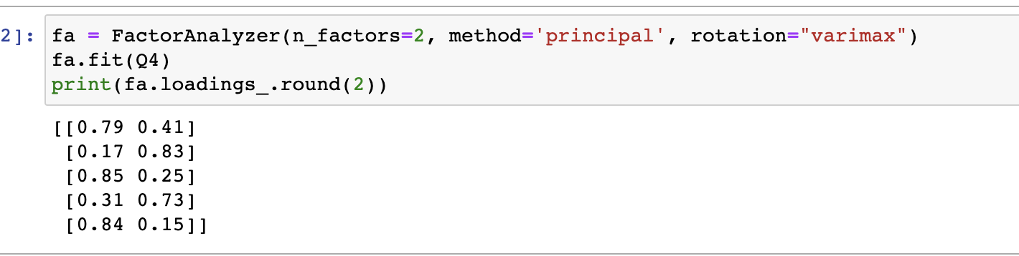
PCA Survey Q4 Skill level
PC1 – 1, 3, 5
PC2 – 2, 4
Two PCs explains 73% of the variance

Slide 59
PCA Survey Q4
Two Principle Components Explained 73.28% of the Variance.
PC1 explained 58.84% of the variance - Person with High Value for PC1 will have low Q1 (0.5567) and low Q3 (0.4819 )
PC2 explained 14.44% of the variance – Person with High Value for PC2 will have high Q5 ( 0.3725 ) and low Q4 ( 0.4244 )

Slide 60
PCA Survey Q4
Interpretation: Q4_Q4_1 [ Q1 ] is ‘I create diagrams that map concepts, facts, and relationships between components’ [ most important ]
Q4_Q4_3 [ Q3 ] is ‘I draw diagrams that show relationships between concepts’ [ 2nd important ]
Q4_Q4_5 [ Q5 ] is ‘I create diagrams to understand complexity’ [ 3rd important ]
Q4_Q4_4 [ Q4 ] is ‘I map out components and their attributes’ [ 4th important ]

Slide 61
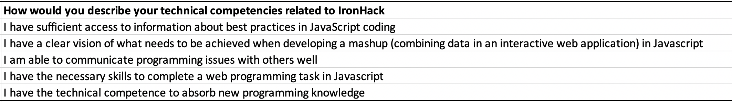
PCA Survey Q5 Individual level absorptive capacity
How would you describe your technical competencies related to IronHack?
Cronbach’s alpha (0.7834 ) ( acceptable consistency)
KMO (0.6526 ) (adequate)
Barlett’s Test (3.955e-61) (significant)

Slide 62
PCA. Survey Q5
Interpretation: Q5_Q5_4 [ Q4 ] is ‘I have the necessary skills to complete a web programming task in Javascript’ [ most important ]
Q5_Q5_2 [ Q2 ] is ‘I have a clear vision of what needs to be achieved when developing a mashup (combining data in an interactive web application) in Javascript’ [ 2nd important ]
Q5_Q5_1 [ Q1 ] is ‘I have sufficient access to information about best practices in JavaScript coding’ [ 4th important ]
Q5_Q5_3 [ Q3 ] is ‘I am able to communicate programming issues with others well’ [ 3rd important ]
Q5_Q5_5 [ Q5 ] is ‘I have the technical competence to absorb new programming knowledge’ [ 5th important ]

Slide 63
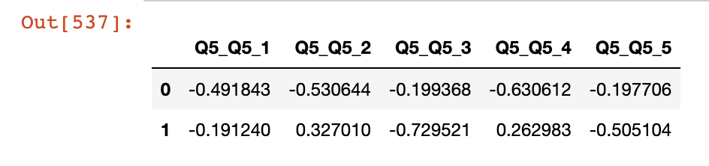
PCA Survey Q5
Two Principle Components Explained 73.28% of the Variance.
PC1 explained 58.84% of the variance - Person with High Value for PC1 will have low Q4 (0.6306) and low Q2 (0.5306 ) and low Q1 ( 0.4918 )
PC2 explained 14.44% of the variance – Person with High Value for PC2 will have low Q3 ( 0.7295) and low Q5 (0.5051)

Slide 64
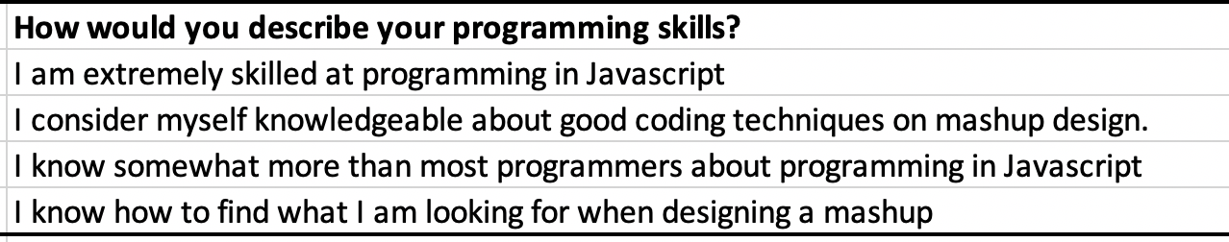
PCA Survey Q7 Individual level absorptive capacity
How would you describe your programming skills?
Cronbach’s alpha (0.8772 ) ( acceptable consistency)
KMO (0.7453 ) (adequate)
Barlett’s Test (1.323e-82) (significant)

Slide 65
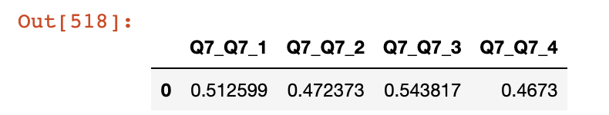
PCA Survey Q7
One Principle Components Explained 73.4% of the Variance.
PC1 explained 73.4% of the variance - Person with High Value for PC1 will have high Q1 (0.5126) and high Q3 (0.5438 ).

Slide 66
PCA Survey Q7
Interpretation:
Q7_Q7_3 [ Q3 ] is ‘I know somewhat more than most programmers about programming in Javascript’ [ most important ]
Q7_Q7_1 [ Q1 ] is ‘I am extremely skilled at programming in Javascript’ [ 2nd important ]

Slide 67
Takeaway
• Understand what the goal of analysis is and choose PCA or EFA for the data analysis
• Having done one analysis there is no need to do the other analysis.

